Slide 1
Insurance Analysis (Data analysis Project) Excelr Educate PVT Ltd

Slide 2
Content
Team
Project Overview
Process
Introduction
Excel
Tableau
Power BI
SQL
Summary

Slide 3
PROCESS
Data
Understanding
Data
Cleaning
Data
Analysis
Insights
Visualisation

Slide 4
Project Overview
Objective: The primary goal of this project is to analyze insurance data to identify key trends, performance metrics, and insights that can aid in decision-making.
Tools Used: Excel, Power BI, Tableau and SQL.
Scope: The analysis covers various aspects such as customer demographics, policy performance, claim analysis, and revenue generation

Slide 5

Introduction to Insurance Analysis
Background: Insurance companies manage vast amounts of data related to policies, claims, and customer information. Analyzing this data is crucial for identifying trends, assessing risk, and improving business strategies.
Importance of Analysis: Proper analysis helps in understanding customer behavior, optimizing pricing strategies, minimizing risks, and enhancing customer satisfaction.
Objective of the Dashboard: To provide a comprehensive and interactive platform for visualizing and understanding the key metrics and insights derived from the insurance data.

Slide 6

Excel
MS-Office

Slide 7
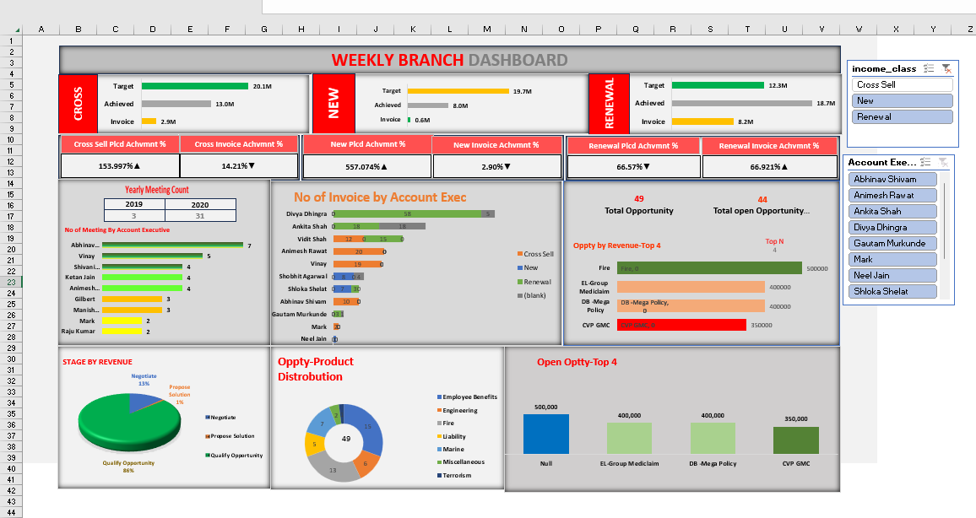
Excel dashboard

Slide 8
Drawbacks Of excel
Scalability Issues: Excel can struggle with handling very large datasets, leading to performance issues and slow processing times.
Limited Advanced Analytics: While Excel is powerful, it lacks some of the advanced analytics capabilities found in specialized tools like Power BI or Tableau.
Error-Prone: Manual data entry and complex formulas can lead to errors, which may affect the accuracy of the analysis.
Collaboration Challenges: While Excel supports collaboration, managing changes, and tracking edits can be difficult when multiple users work on the same file.
Lack of Automation: Excel has limited automation features compared to other tools, which can make repetitive tasks time-consuming.

Slide 9

Tableau (Desktop)
Analytical Software
This Photo by Unknown Author is licensed under CC BY-SA

Slide 10
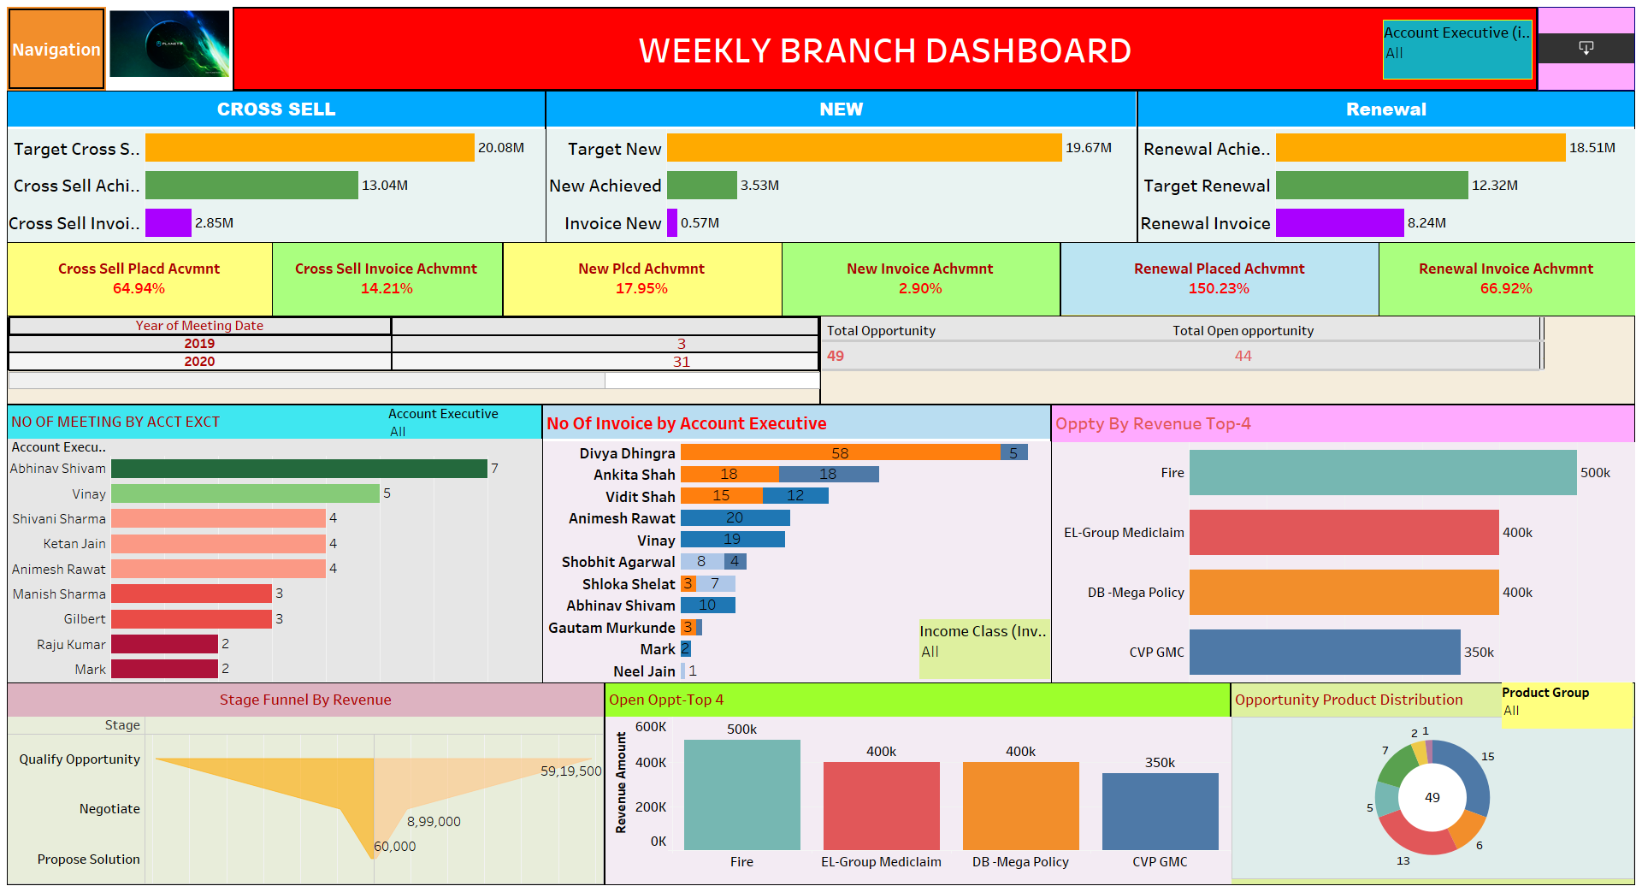
Tableau Dashboard

Slide 11
drawbacks of Tableau
Cost
Steep Learning Curve for Advanced features:- Complexity for beginners and Limited built-in visuals
Limited Data Processing:- Basic data preparation and Dependence on external tools
Performance Issue with large Data Sets:- Slow performance and hardware requirements
Limited Customization in Visualisation:- Predefine visual styles and limitations in scripting
Data Source Dependency:- Live connection limitation and limited offline functionality
Challenges with Embedding and Integration
Data Blending Limitations

Slide 12

Power BI
Analytical Software

Slide 13
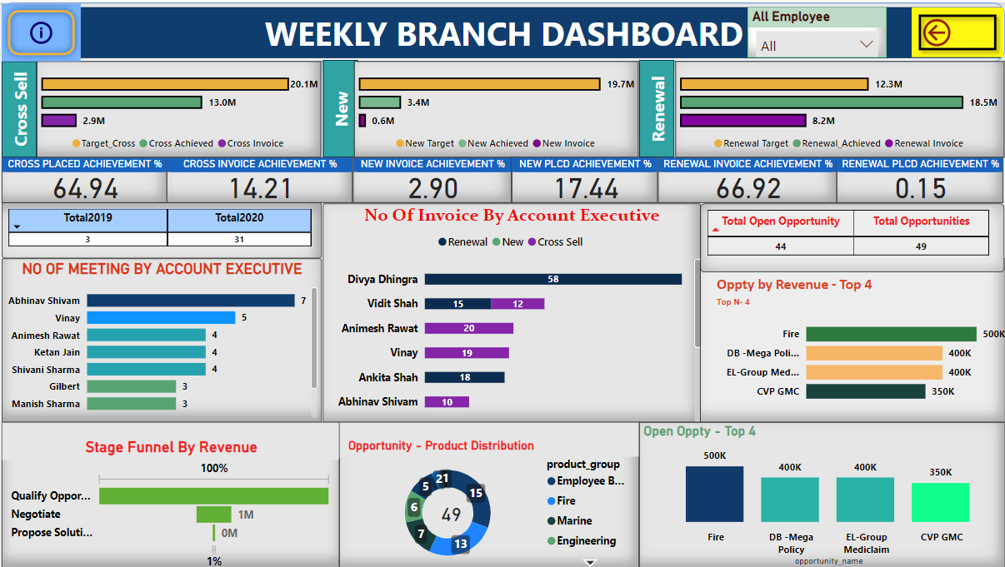
POWER BI dashboard

Slide 14
Challenges Faced and Solutions in power bi
Challenge:- Collaboration on Different Power Bi Files
Issue: Difficulty in integrating multiple Power BI files for collaboration.
Solution: Used Power BI Services to combine and collaborate on different files, ensuring a seamless interactive dashboard experience.

Slide 15

MySQL
Query Language

Slide 16
Purpose of stored procedure
The SQL stored procedure KPI_FOR_PROJECT was developed to calculate KPIs based on different income classes such as "Cross Sell," "New," and "Renewal.“
It automates the process of retrieving and calculating target, achieved, and invoice values, which are essential for evaluating the project's financial performance.

Slide 17
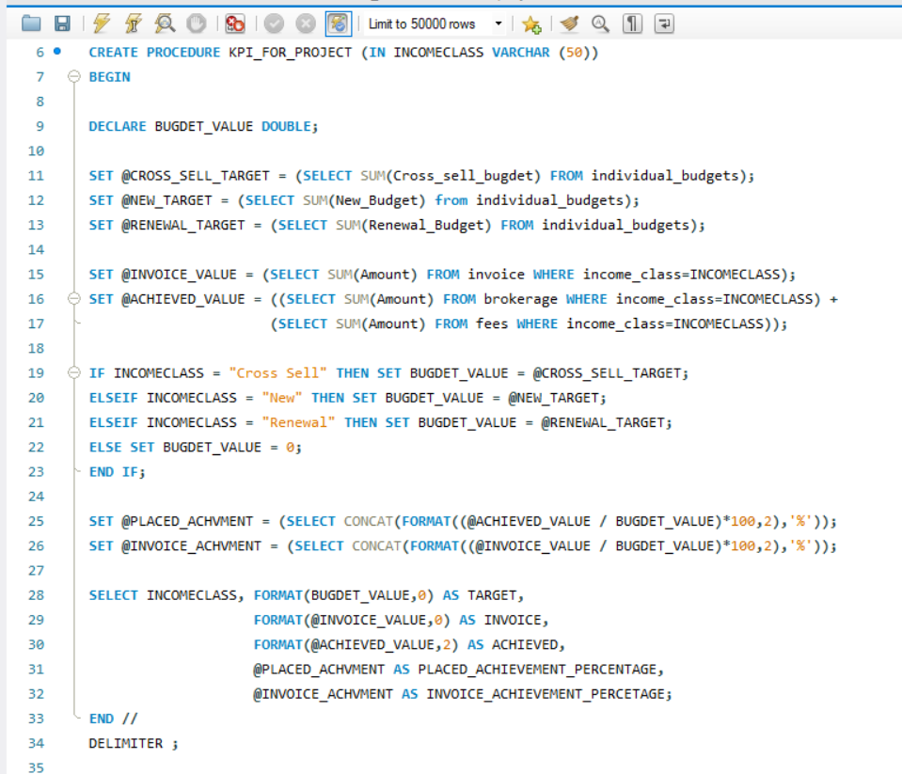
SQL queries

Slide 18
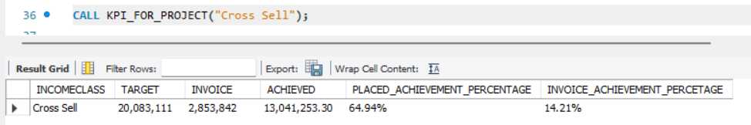
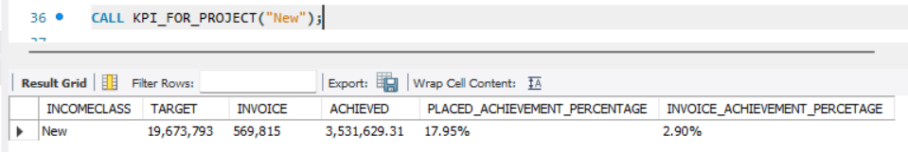
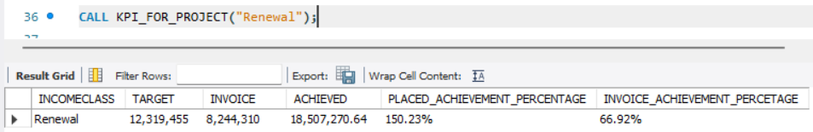
SQL queries output

Slide 19
Key calculations and output
Target Calculation: Determines the budgeted target for each income class.
Invoice Value: Sums up the total invoiced amount for the specified income class.
Achieved Value: Combines amounts from brokerage and fees to calculate the total achieved amount.
Achievement Percentages: Computes the percentage of the target achieved based on the actual values.
Outputs: The procedure provides a detailed table showing income class, target, invoice, achieved values, and corresponding percentages.

Slide 20
Impact and Benefits of Using Stored Procedure
Easy to reuse: Stored procedures are like recipes. Once you write a recipe, you can use it again and again without rewriting it.
Faster performance: Stored procedures are like shortcuts. They help the computer do tasks faster because it doesn't have to think about what to do every time.
Safer data: Stored procedures are like locks. They help keep the bad guys from getting to our important data.
Less mistakes: Stored procedures are like checklists. They help us make sure we don't forget anything important.
Easier maintenance: Stored procedures are like instruction manuals. They make it easier for others to understand what we did and how to fix it if something goes wrong.
Accuracy: Ensures that KPI calculations are precise, enhancing the reliability of the data.
Efficiency: Speeds up the analysis process, allowing for quicker decision-making based on accurate and up-to-date information.
In short, stored procedures make our lives easier, faster, safer, and more accurate!

Slide 21
Summary
The summary document provided is for an Insurance Data Analysis project by a team from ExcelR Educate PVT Ltd. It looked to analyze insurance data for key trends, metrics, and insights that could drive better decision-making. It would involve the use of Excel, Tableau, Power BI, and SQL tools in the exploration of such aspects as customer demographics and policy performance, claim analysis, and revenue generation. Such major steps were data understanding, cleaning, analysis, and finally visualization. There will be an interactive dashboard using Tableau and Power BI to visualize the insights and SQL for developing stored procedures that would automate the KPI calculations. The project also gave the pros and cons of the tools that would be used, giving a full overview of how the data had been handled and analyzed.

Slide 22


